Slide 1
CAPSTONE PROJECT - PYTHON
Mentor Name:Jaya Pandey
Student Name:Sindupriya Itha

Slide 2
CONTENTS
INTRODUCTION
DATA ANALYSIS USING PYTHON
VISUALIZATION OF PYTHON
CONCLUSION

Slide 3
INTRODUCTION
In an age where the financial industry is marked by intense competition and evolving customer expectations, understanding why customers leave or stay with a bank is more critical than ever. It directly impacts a bank's growth, profitability, and overall success.
A data exploration will shed light on customer churn within the banking sector, employing Python as our tool of choice.
Python, a versatile and powerful programming language, allows us to dig deep into data, extract meaningful insights, and develop predictive models to inform decision-making.

Slide 4
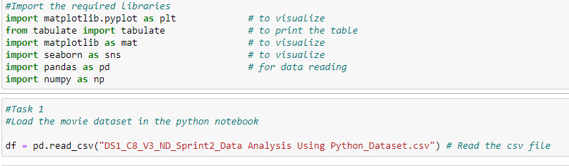
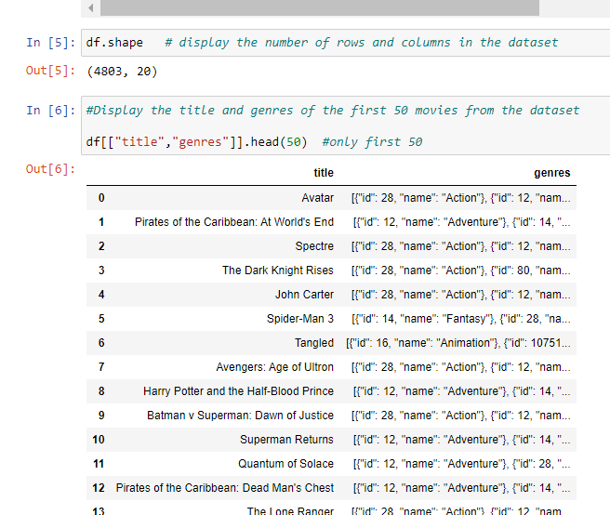
DATA ANALYSIS USING PYTHON
INTERPRETATION:
Task 1: Loading the dataset and displaying the number of rows and columns gives an insight into the dataset size.
Displaying the titles and genres of the first 50 movies provides an insight into movie titles and its categories present in the dataset.

Slide 5
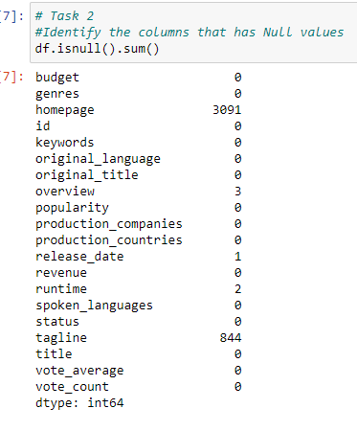
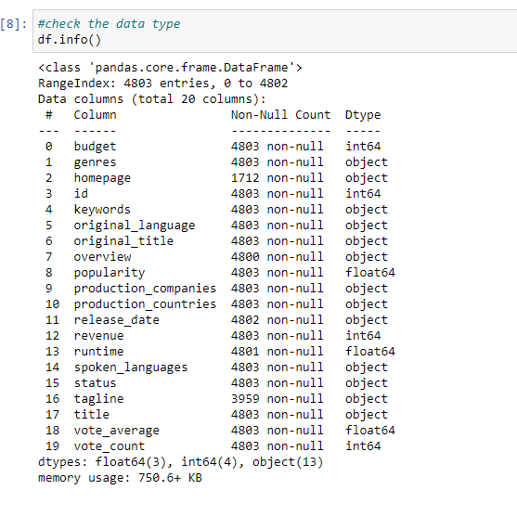
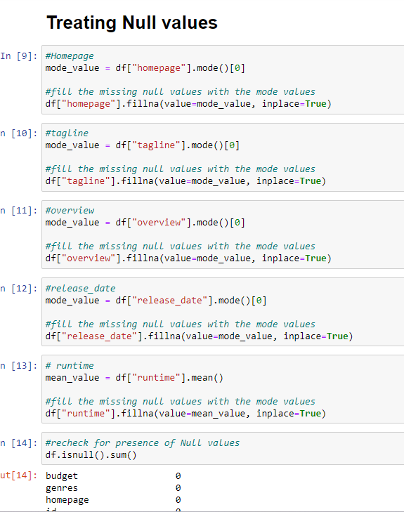
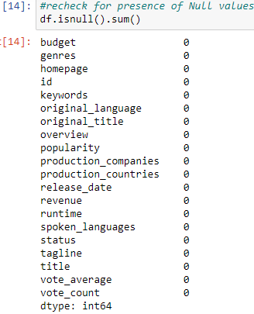
INTERPRETATION:
Task 2: Identifying columns with null values and performing required treatments ensures that the dataset is free from missing, duplicating or incomplete data.

Slide 6
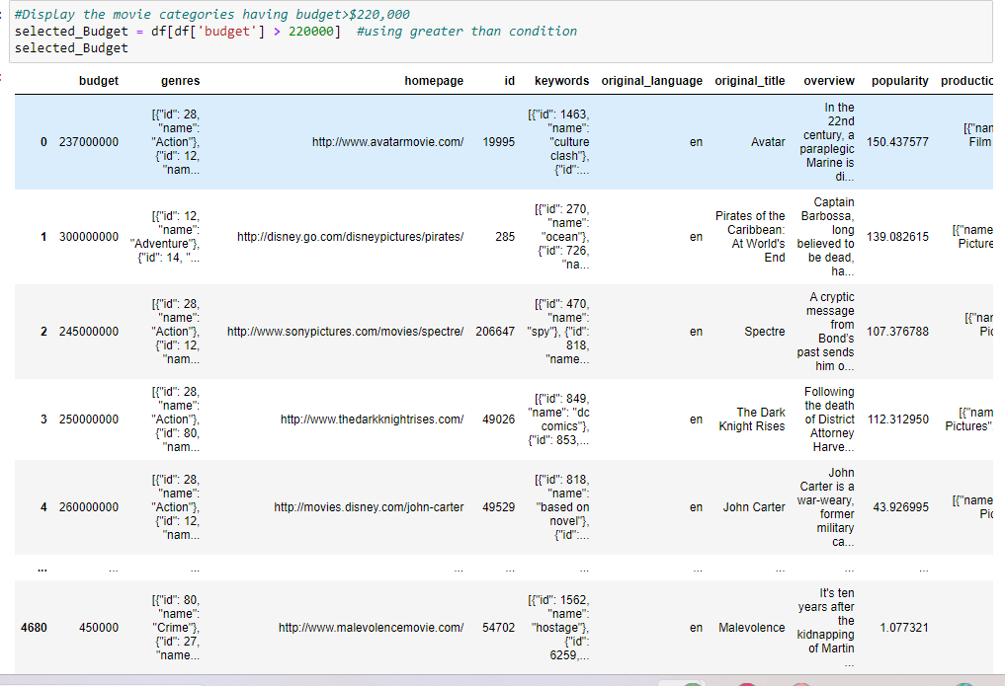
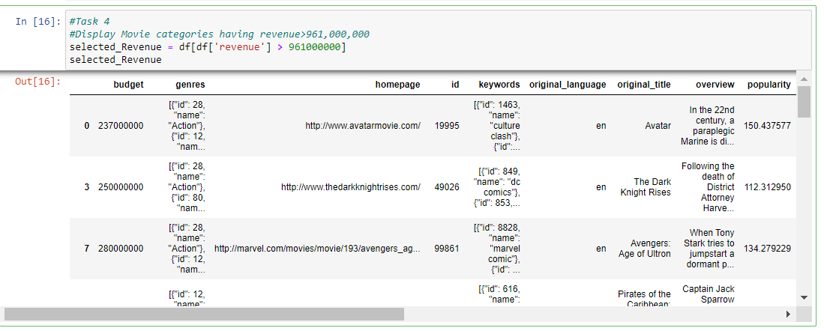
INTERPRETATION:
Task 3: Displaying movie categories with budgets exceeding $220,000 shows the investment trends with respectto different genres.
Task 4: Display movie categories having revenues exceeding $961,000,000 shows the most commercially successful genres.
#Task 5
#How did you select first 50 movies?
#Which function have you used to display title and genre of those movies
#I selected first 50 movies using the df and defining required columns i.e., title and genre and top 50 titles by using head function limiting to 50 by providing 50 in the braces.

Slide 7
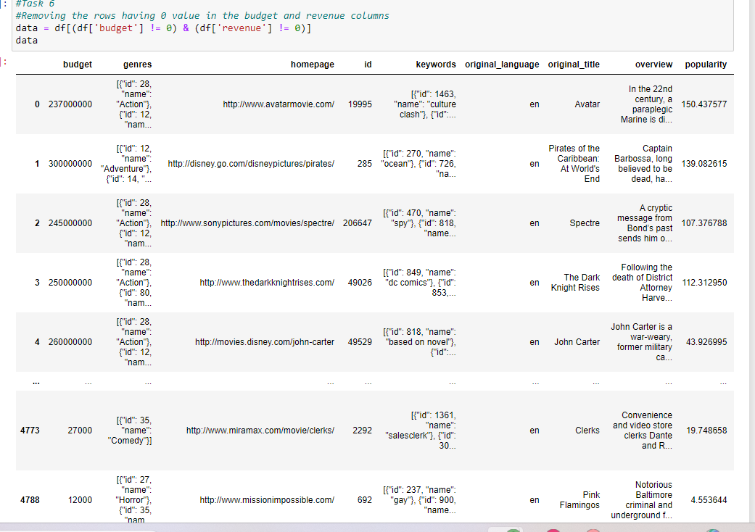
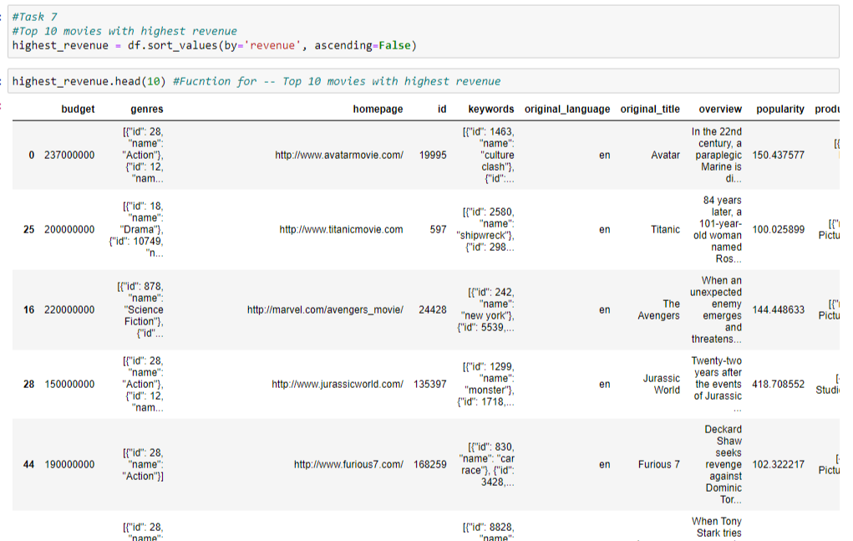
INTERPRETATION:
Task 6: Removing rows with zero in budget and revenue ensures that there’s no missing values and the data is cleaned now for further analysis.
Task 7: Listing the top 10 movies with the highest revenues and least budget provides information regarding movie performance and its financial gain.

Slide 8
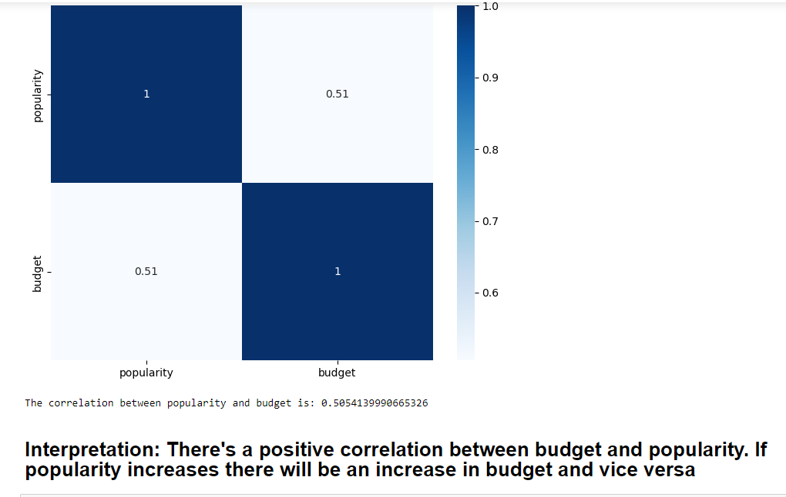
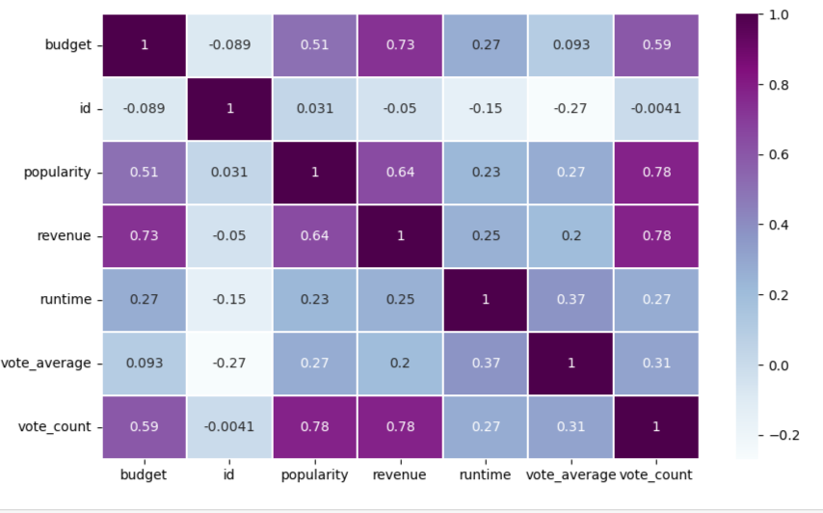
INTERPRETATION:
Task 8: There's a positive correlation between budget and popularity. If popularity increases there will be an increase in budget and vice versa.
Depicted using a Heat MAp

Slide 9
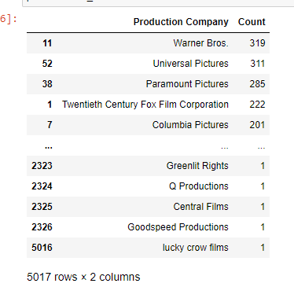
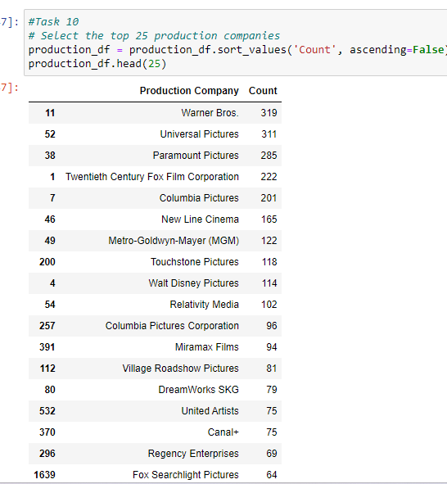
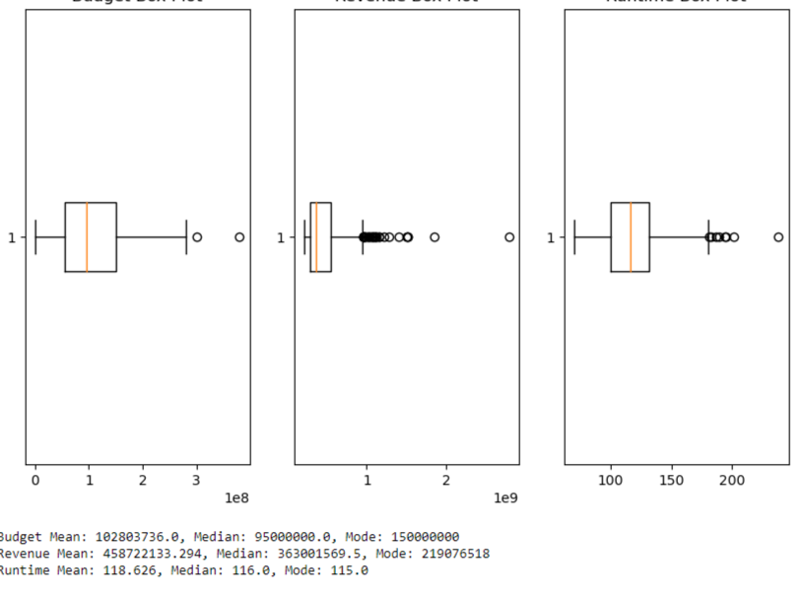
INTERPRETATION:
Task 9: This analysis provides insights into the distribution of production companies involved in the number of movie making.
Task 10: Displaying the names of top 25 production companies in descending order based on the number of movies produced gives the list of top production houses and how many movies they had produced.

Slide 10
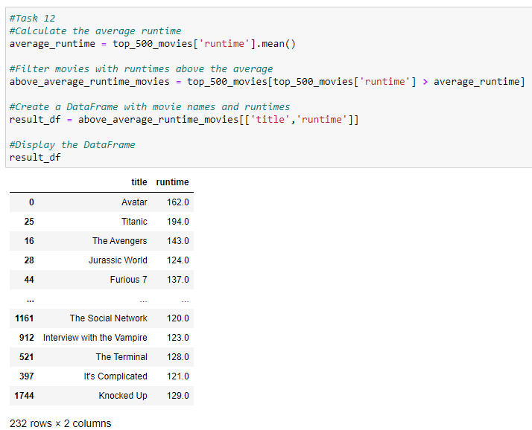
​
Interpretation:
The runtimes of movies varies significantly few movies are short and few movies are long. The data represents there's diverse range of genres.

Slide 11
CONCLUSION
#Task 10
Warner Bros.,Universal pictures paramount pictures , 20th century FOX, Columbia Pictures have higher number of movies produced and are more active in the film industry as per the given dataset
Top production companies has higher market share based on the number of movies they released.
Their is a positive correlation between budget and popularity, as budget increases popularity increases. And vice-versa
The run time of the movies are varied from the same production company.
Genres also has a direct influence on movie success so directors have to pay attention on the genre for better profits.
The database has various attributes like budget, genre, popularity this helps in movie makers choose genre, actors, idea on certain replacement costs included, that’s profitable while filiming a new movie.

Slide 12


